Slide 1

Knowledge4Life
June 29, 2026

Slide 2

OHDSI
The Community and Science behind it

Slide 3
Before we dive in
Internal
Notes:
> Mentimeter
Word-Cloud (When you hear OHDSI, what comes to mind? or similar question)
Also: there is a Q&A open throughout the session, if you have any questions please just paste them in the chat anytime so we can answer them at the end of the session

Slide 4
Before we dive in
What comes to mind when you hear
‘OHDSI’?
Internal
Notes:
Word-Cloud (When you hear OHDSI, what comes to mind? or similar question)

Slide 5

Before we dive in
Or join via https://www.menti.com/alfgo9w78rk3
Internal
Notes:
Word-Cloud (When you hear OHDSI, what comes to mind? or similar question)

Slide 6
Agenda
Part 1: Introduction OHDSI
The Vision
The Issue
The Approach
Part 2: The Building Blocks
The Structure: OMOP Common Data Model
The Semantics: Vocabulary
The Engine: Methods
The Glue: Community & Conventions
How it all comes together: The Network Effect
EHDEN and DARWIN EU
Part 3: Role of Data4Life in the OHDSI ecosystem
Part 4: Q&A
Internal

Slide 7
Part 1: Introduction OHDSI

Slide 8


Introduction OHDSI | The Vision
Definition: Observational Health Data Sciences and Informatics (OHDSI, pronounced "Odyssey") is an interdisciplinary, open-science collaborative that uses large-scale analytics to generate reliable evidence from observational health data.
Vision: “A world in which observational research produces a comprehensive understanding of health and disease." → Move from one-off studies to a global pharmacovigilance and drug effectiveness system
Idea: Systematically generate evidence across treatment × outcome combinations to answer three Q’s:
How often does the outcome occur? → Characterization
Does a treatment cause an outcome? → Population-level effect estimation
How likely will a person experience an outcome? → Patient-level prediction
Internal

Slide 9

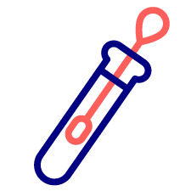




Introduction OHDSI | The Issue
Vast amounts of health data are generated every day.
Yet little of it can be used for research that could improve patient outcomes and decision-making because data most often is…
not harmonized,
stored in isolated systems,
hard to share.
Notes:
…not harmonized: inconsistent formats, structures, and clinical classification prevent analysis across sources
…locked in silos: storage in isolated systems that don't interoperate
…hard to share: privacy, legal, and governance constraints keep data from being pooled

Slide 10




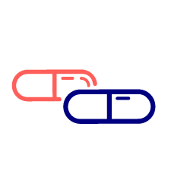






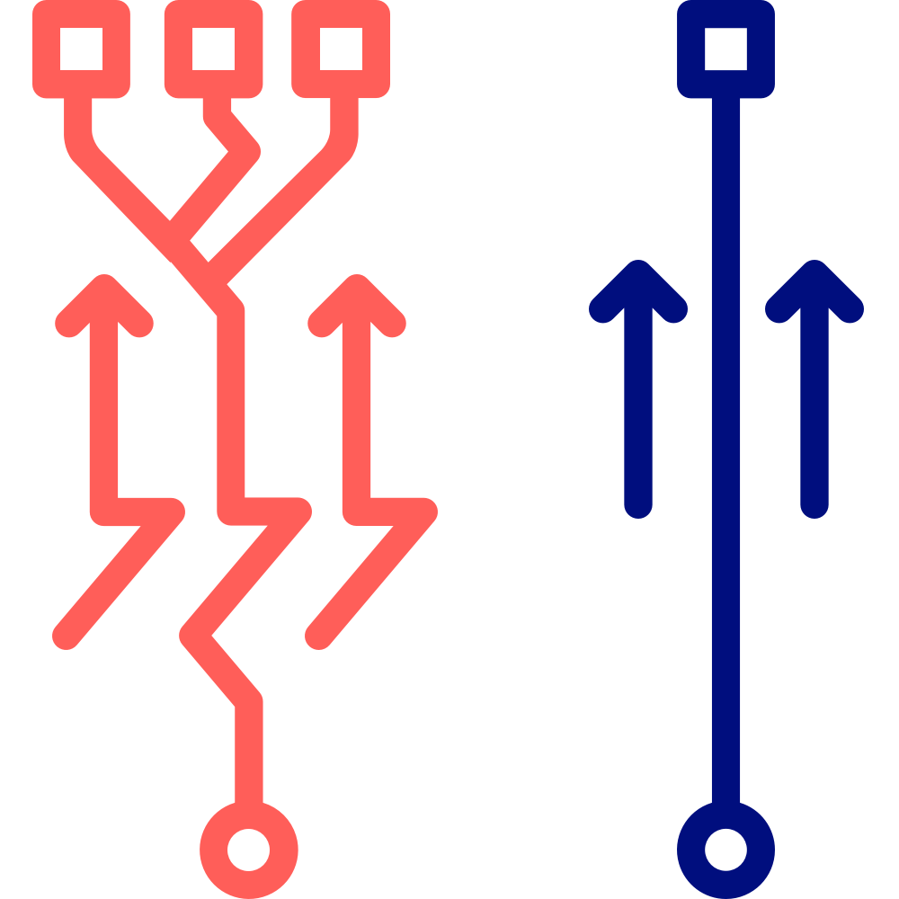




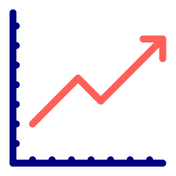
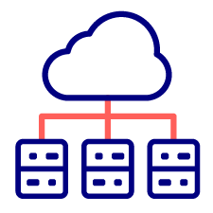



Introduction OHDSI | The Approach
WITHOUT OHDSI
WITH OHDSI
Individual analytics per site
Plug-in analytics, one base
OMOP
CDM
Adherence
Mortality
North America
Southeast Asia
China
Europe
one standard, one adapter
Prediction
Safety
UK
Japan
India
South Africa
Performance
Network
Switzerland
Italy
Israel
Open
One analytics script per study site
Transparent
Scalable across the OHDSI network
Reproducible
Not scalable · not transparent
Transparent, auditable, open-source
Expensive, slow, expert-only
Accessible beyond expert statisticians
Notes:
The Universal Power Adapter Analogy → different power outlets - your laptop is a device with the same needs (power) but can’t plug in everywhere without adapter / healthcare data has exactly the same problem
Every hospital has its own outlet (stores data in different format) → study diabetes across 10 hospitals, neeeds to run 10 different queries → OBSERVATIONAL MEDICAL OUTCOMES PARTNERSHIP CDM is agreement to install same type of outlet everywhere / single, standaradized structure

Slide 11
Part 2: The Building Blocks

Slide 12

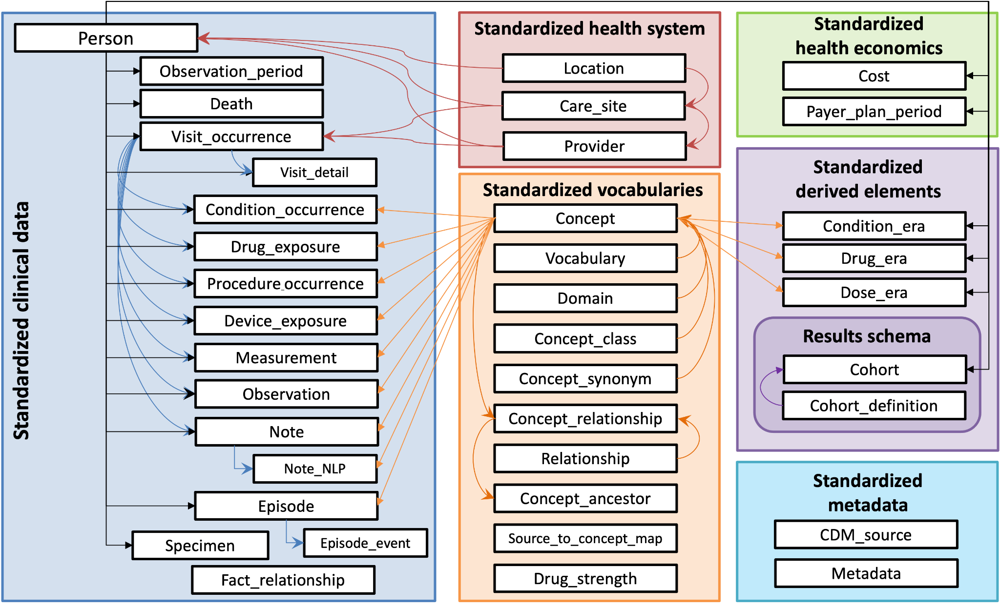
OMOP CMD | The Structure
Observational Medical Outcomes Partnership (OMOP) Common Data Model (CDM):
Standardized relational schema: every source maps its data to the same tables and fields, whatever the original system (EHR, claims, registry)
Person-centric design: data organized around patients over time (conditions, drugs, measurements, observation periods)
Structure and semantics are separated: the CDM defines how data is organized; the Vocabulary (next building block) defines what the codes mean

Slide 13

OMOP Vocabulary | The Semantics
Idea:
Map source codes that encode the same clinical fact onto a common standard concept ID
→ meaning is identical across sites.
“Diabetes mellitus type 2”: Same clinical fact, three different source codes.
Site | Source Code | OMOP Concept ID
Site 1 (ICD-9-CM) | “250.00” | 201826
Site 2 (ICD-10) | “E11” | 201826
Site 3 (SNOMED CT) | “44054006” | 201826
Analyses are defined on the standard concept IDs and run unchanged everywhere, even when sites use different coding systems.
The vocabulary includes hierarchies (e.g., query a concept and include all more granular facts beneath it).
Challenge:
Source and target vocabularies change constantly, so keeping the mappings current is resource-intensive.
This work is maintained by the OHDSI community and coordinated at Columbia University.
Browse OMOP Standardized Vocabulary at athena.ohdsi.org

Slide 14



OHDSI Methods | The Engine
Open-source R packages: The Health Analytics Data-to-Evidence Suite (HADES) provides open-source R packages for running state-of-the-art large-scale analytics against the OMOP CDM.
Cohort creation & characterization:
ATLAS: Web UI for defining cohorts and run characterizations.
Achilles: Database-level characterization and summary statistics.
Data quality: The DataQualityDashboard allows systematic data-quality checks against the OMOP CDM.
Federated analytics:
Cohort Discovery (HDR UK) is a live feasibility check that returns counts of matching individuals across many datasets before any data holder needs to be contacted by a researcher. → currently only UK data holders included!
Strategus orchestrates HADES modules across sites: one analysis specification, executed identically at every node (data does not leave the site, only the aggregated results).
Results viewer: Standardized Shiny apps are used for reviewing study results.

Slide 15



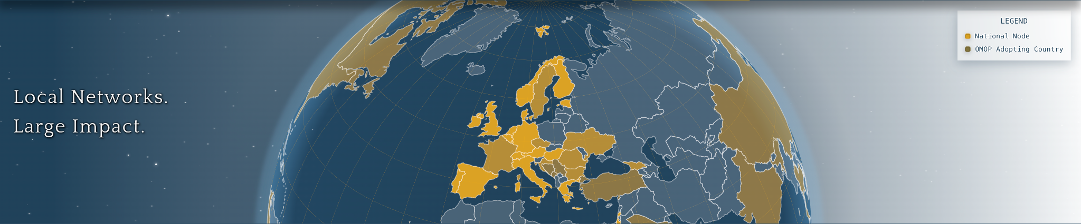
OHDSI Community | The Glue
Join the Journey!
Everyone is welcome to actively participate in OHDSI (must read: ‘The Book of OHDSI’)
Regional chapters provide local expertise and presence across geographical areas, such as the European chapters
National Nodes:
Strengthen national coordination and community building while supporting OMOP implementation and data holder onboarding
Promote participation in international studies and bridging local practice with European Policy
Nodes operate through open, community-driven principles.
Notes:
https://www.ohdsi-europe.org/

Slide 16



OHDSI Community | The Glue
Join an OHDSI forum
Summer Schools & Workshops
Hands-on training globally, including annual symposia, EHDEN Academy
Join a working group
Open to all collaborators, over 30 active working groups, focus on strategic objectives
Community Calls
Weekly calls (Global & Europe)
Notes:
How to engage in the community?
Add: July 7 showcasing atlas 3.0 in the OHDSI Global Community Call
Working group: THEMIS background → the idea of the Data Quality Dashboard emerged from this working group; they are advancing the best practices,

Slide 17

OHDSI | How it all comes together
EHDEN (European Health Data & Evidence Network)
Launched in 2018
Public-private partnership under the Innovative Medicines Initiative (IMI)
→ Goal: Building a large-scale federated data infrastructure that harmonizes RWD across Europe
How does it work?
EHDEN recruited data partners who received funding and technical support to map their data to OMOP CDM
As of September 2024, EHDEN portal included 210 harmonized data sources from 30 countries and over 70 publications
EHDEN Academy
Over 5,350 learners across > 100 countries trained on OMOP, real-world evidence methods, federated research: Free and open to the public!
Notes:
essentially doing the groundwork of standardizing health data at scale.
5 year funded → transitioned to the EHDEN Foundation to sustain legacy & infrastructure
On demand training and development programmes developed by OHDSI and the EHDEN community
So the rough sequence is: OHDSI/OMOP builds the standard → EHDEN harmonizes European data to that standard at scale → DARWIN EU leverages that harmonized, federated infrastructure for medicines regulation.
Which is also why the connection I mentioned in the slides holds up: EHDEN data partners were among the first to join DARWIN EU — because their data was already OMOP-ready.

Slide 18
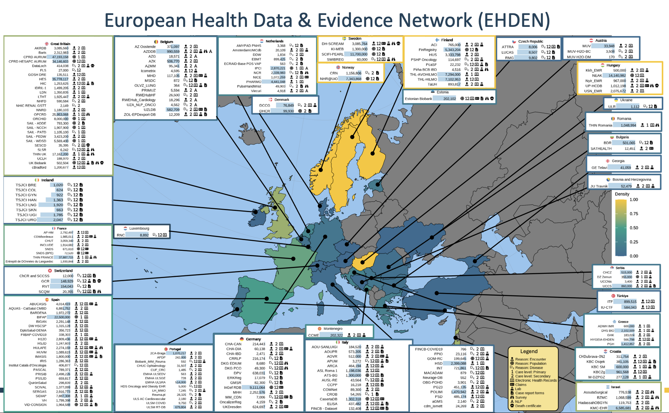
A new horizon in real-world clinical evidence and open science
Figure from Blacketer et al., 2025
Notes:
Italy > great britain > spain: highest representation of data sources

Slide 19
OHDSI | How it all comes together
DARWIN EU® (Data Analysis and Real World Interrogation Network)
Established by the European Medicines Agency (EMA) & the European Medicines Regulatory Network
→ Goal: to deliver timely and reliable real-world evidence on the use, safety, and effectiveness of medicines from real world healthcare databases across the EU
What will DARWIN EU® deliver?
Support of regulatory decision-making by providing a source of high-quality, validated real-world data on the use, safety and efficacy of medicines
Addressing specific questions by carrying out high-quality, non-interventional studies
Key figures
263,223,000
~ 110
~ 40
Notes:
Service provider: (Erasmus University Medical Center Rotterdam) → as of 2024 fully operational
Data stays local and is analyzed locally, with only aggregated results shared
Privacy-by-design approach enabling large, multi-database studies across Europe
Patients providing data
studies delivered since 2022
data partners as of 2026

Slide 20
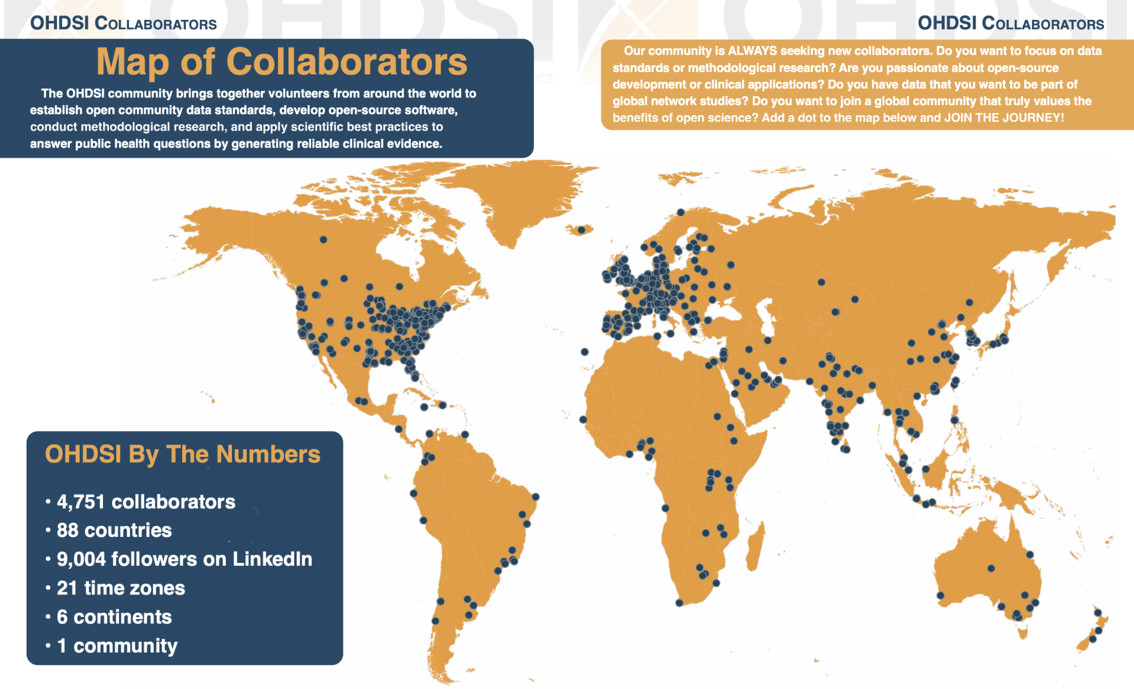
OHDSI | How it all comes together
Notes:
This is OHDSI in one image.
Every dot on this map is a collaborator: 4,751 of them, across 88 countries, 6 continents, 21 time zones. And the thing I love about this slide is that last bullet: 1 community. That's kind of the whole point.
What brings all these dots together is a shared mission

Slide 21
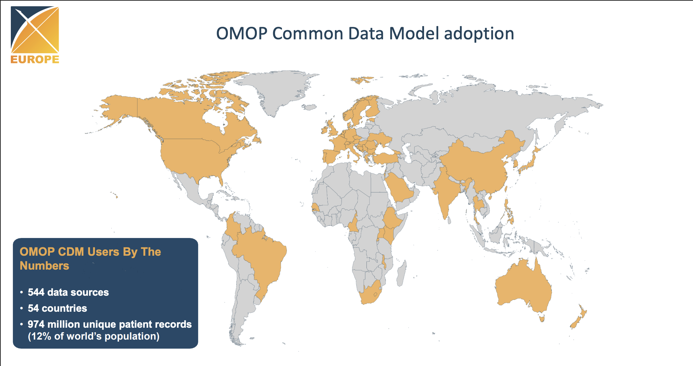
OHDSI | How it all comes together

Slide 22
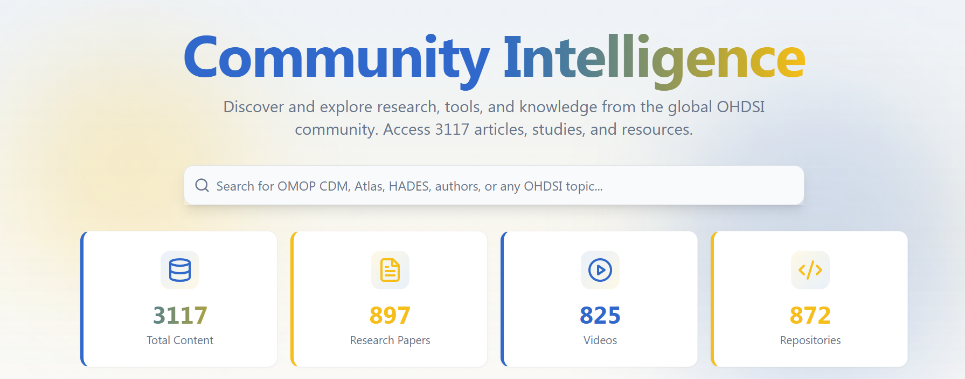
OHDSI | How it all comes together
https://dash.ohdsi.org/

Slide 23
Revisit | The Issue
Vast amounts of health data are generated every day.
Yet little of it can be used for research that could improve patient outcomes and decision-making because data most often is…
not harmonized,
stored in isolated systems,
hard to share.
→ OMOP CDM + OHDSI Standardized Vocabulary
→ OHDSI Networks like EHDEN and DARWIN
→ Data stays local, only aggregated results are shared
Notes:
…not harmonized: inconsistent formats, structures, and clinical classification prevent analysis across sources
…locked in silos: storage in isolated systems that don't interoperate
…hard to share: privacy, legal, and governance constraints keep data from being pooled

Slide 24




Interlude | Comparison with Other Data Standards
Analysing data at scale
Moving data between systems
Capturing data at source
OMOP: Secondary data analysis across sources
Optimized for large-scale, standardized observational research across sites
Due to the standardized vocabularies, data means the same thing everywhere
But: getting source data harmonized into OMOP is costly and effort-intensive
FHIR: Data exchange between systems
Real-time, API-based data exchange across organizations
The dominant interoperability standard in Germany
But: doesn't inherently solve semantic harmonization
openEHR: Persistent storage of the clinical record
Semantically rich clinical documentation, retained over the full patient history
Archetypes: reusable, governed models that define clinical concepts in detail
But: not designed for cross-site harmonization or federated analytics
Takeaway: These data standards complement each other. They don't compete.

Slide 25
Part 3: Role of Data4Life in the OHDSI ecosystem

Slide 26
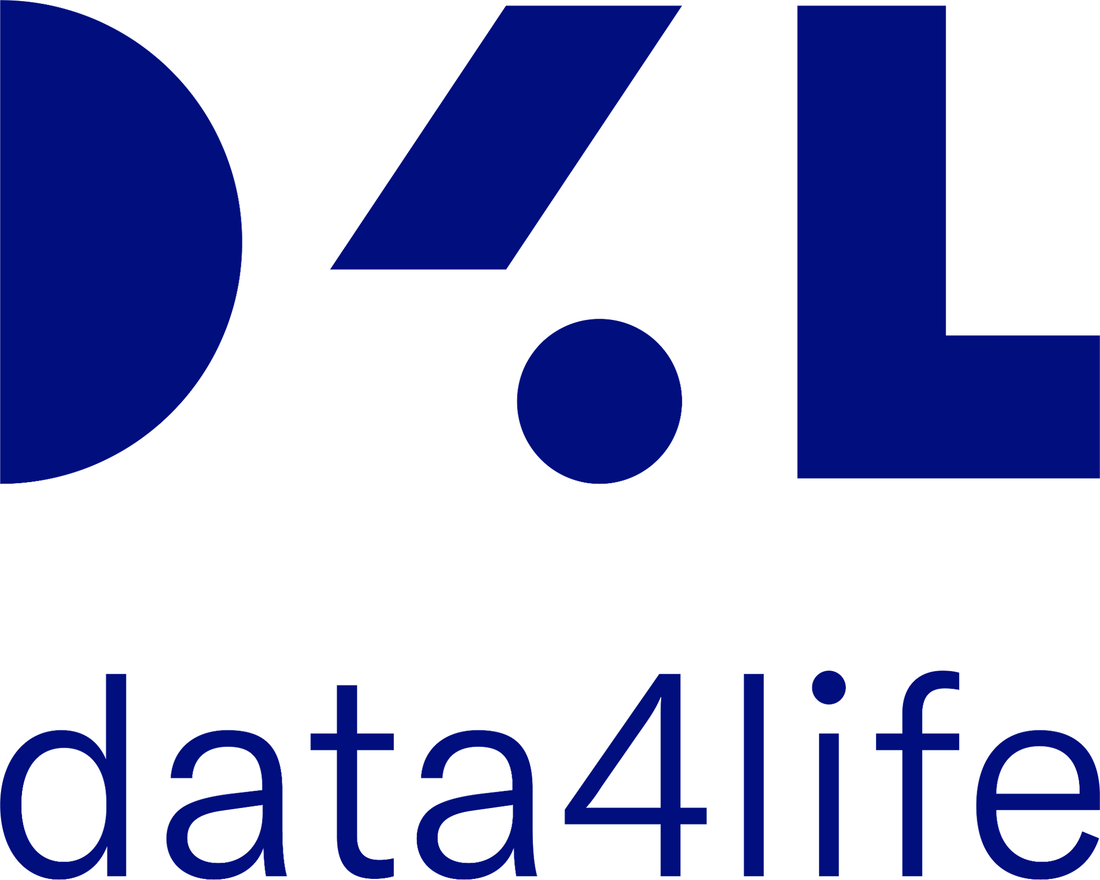
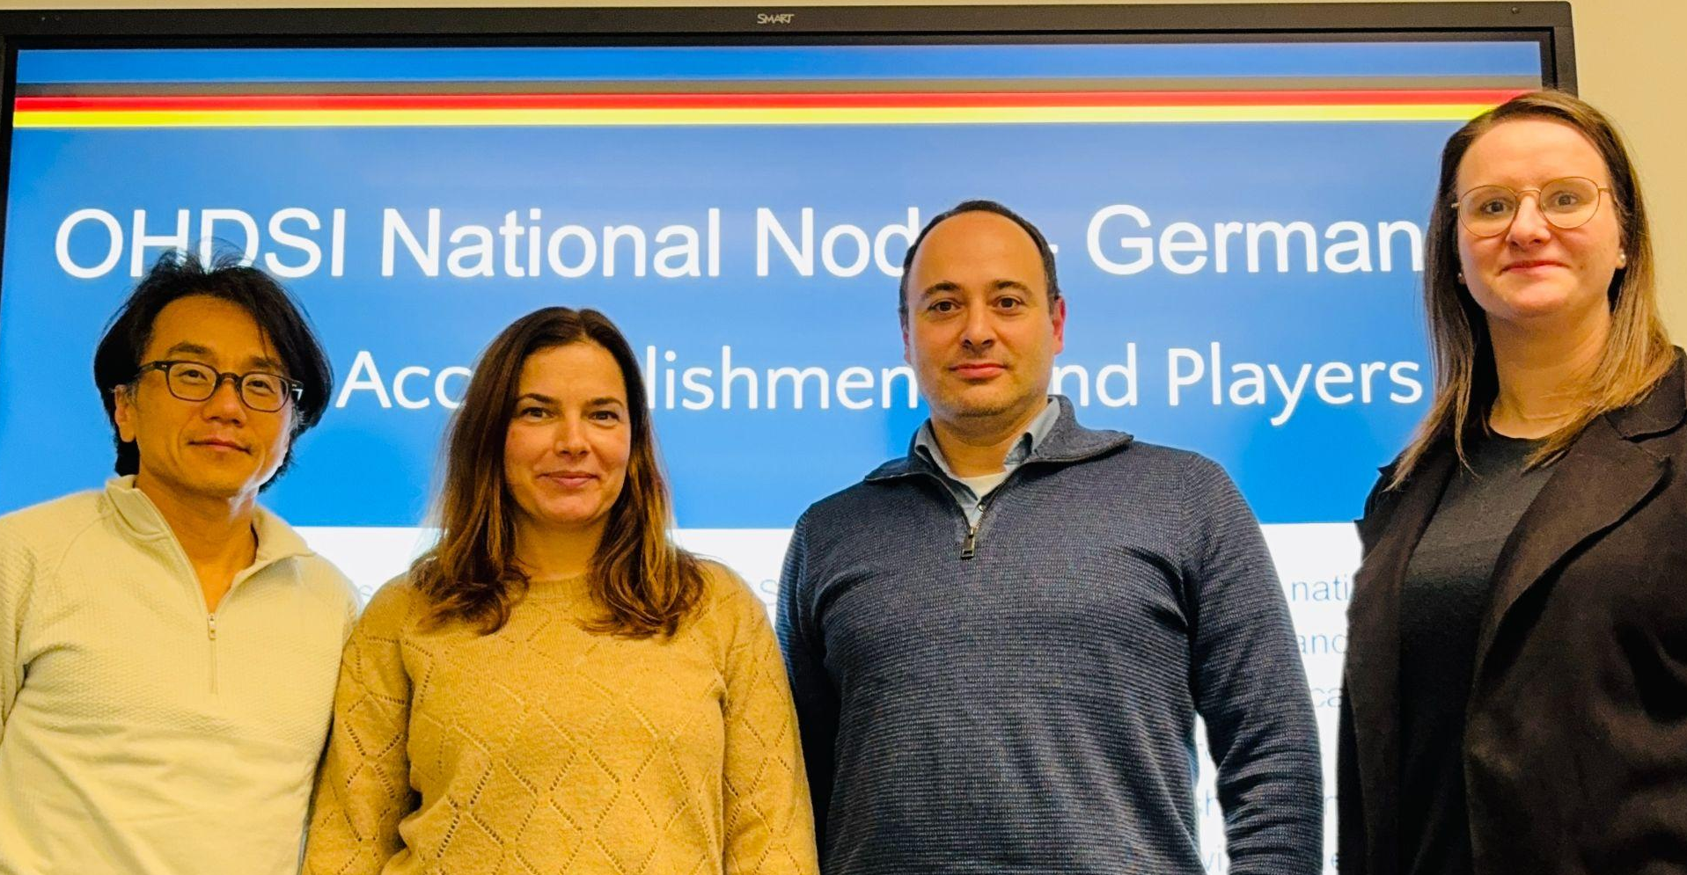
OHDSI Germany | Connecting the Data
OHDSI Germany Mission
Help German institutions adopt OMOP CDM and join OHDSI network studies
Federated: queries run locally, only aggregate results shared
OHDSI Germany Current state
MII: 38 university + 3 non-university DIZ = 41 total sites
NUM-DIZ: 22 sites committed to OMOP translation
But there is still more work to be done → Establishment of OHDSI Germany e.V. (formal association)
OHDSI Germany Community Snapshot
~ 130 community members
~ ca. 8 data partners
~ monthly community calls (responsible for Europe Call on September 10)
~ Founded in Spring 2021 (one of the oldest European nodes)
Co-Leadership
Ben Illigens (D4L data4life gGmbH)
Ines Reinecke (TU Dresden / Med. Univ. Lausitz)
Gennadi Rabinovitch
Michéle Zoch (TU Dresden)

Slide 27


O
D
I
OHDSI: Our Strategic Trajectory
H
S
From national co-lead to hosting the world's largest European RWE symposium
2025
2026
2027
2028
D4L becomes OHDSI Germany Co-Lead
With TU Dresden. National node.
OHDSI Germany e.V.
Formal association. First network study.
OHDSI Summer School
Berlin/Potsdam. Hosted by D4L, co-led with partners.
OHDSI Europe Symposium
Berlin/Potsdam. Competitive pitch. EU-wide event. >350 participants
Global OHDSI network activities 2026 and several OHDSI WG participations
Seolhwa
Oxford Summer School
Done
Done
Done
Mario
Sweden Summer School
Martin
Columbia Summer School
Tim, Peter, Karthik
NUS Singapore Summer School
OHDSI APAC - Tim
Korea + workgroup engagement
AHDEN Australia - Tim and Ben
Nicole Pratt OHDSI NT support
OHDSI Africa - Tim and Ben
Cynthia Sung 2026 support
OHDSI LatAm - Pablo
Pablo as lead and key support
Notes:
OHDSI Symposium Finland

Slide 28
Part 4: Q&A

Slide 29
What terms & concepts were the most interesting to you?
The End | Check-in
Notes:
> Mentimeter

Slide 30
Where do you see yourself becoming more active in the OHDSI community?
The End | Check-in
Notes:
> Mentimeter

Slide 31
The End | Q&A
Notes:
> Mentimeter

Slide 33
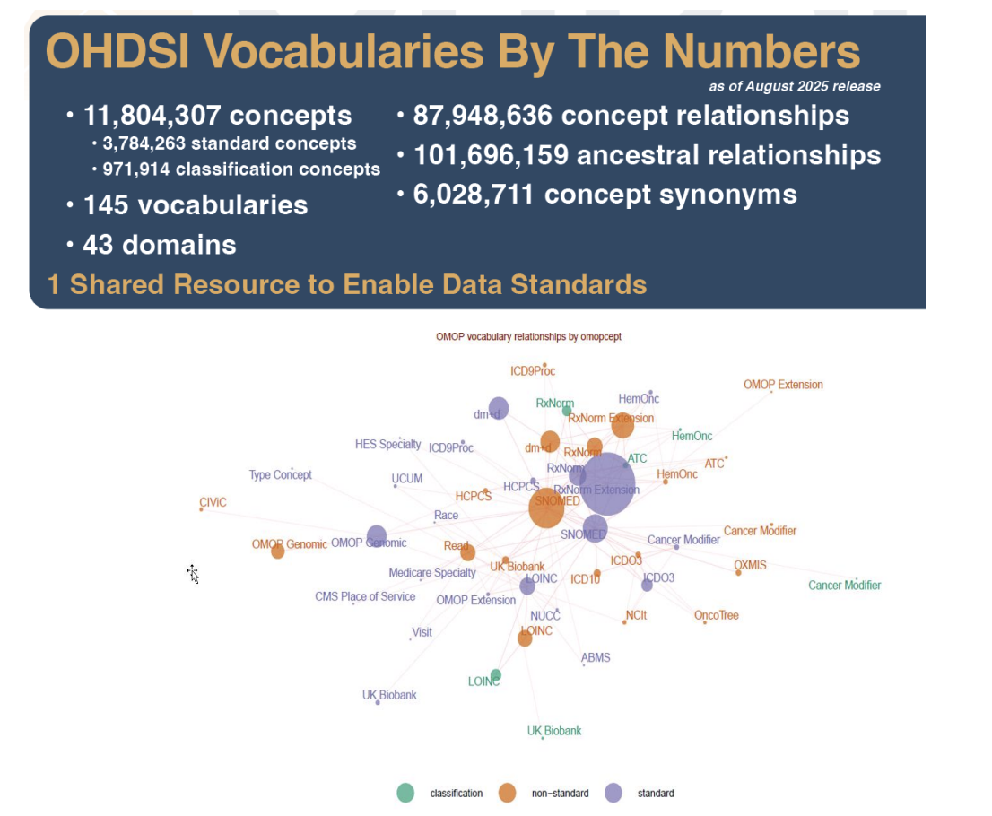
OMOP Vocabulary | The Semantics

Slide 34
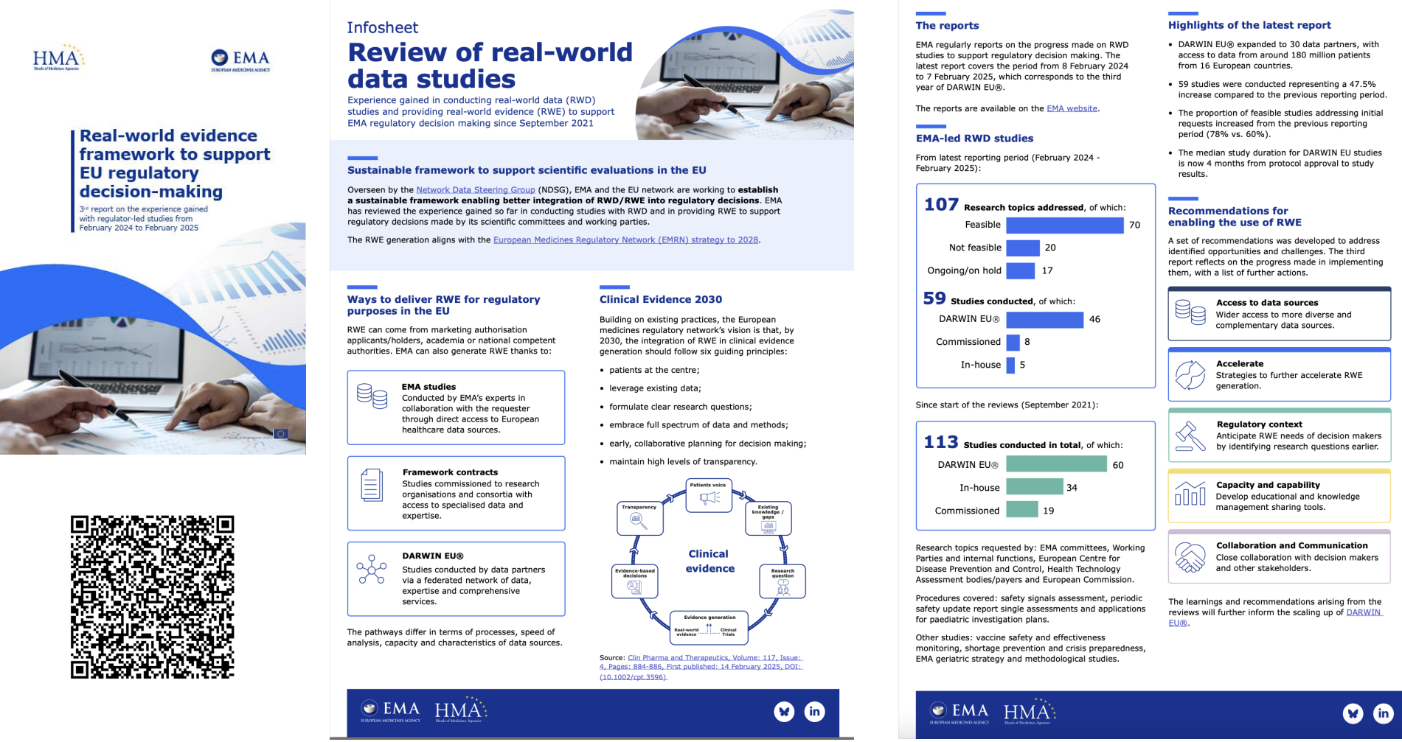
OHDSI | How it all comes together
DARWIN EU® (Data Analysis and Real World Interrogation Network) was established by the European Medicines Agency (EMA) and the European Medicines Regulatory Network to deliver timely and reliable real-world evidence
How does it work?
DARWIN EU is a federated network, with access to data from around 250 million patients, and has assessed over 100 research topics, with 88 studies completed or ongoing
Notes:
timely and reliable real-world evidence on the use, safety, effectiveness of medicines drawing from real world healthcare databases across Europe
federated network: data stays local and is analyzed locally by data partners only with aggregated results shared, a privacy-by-design approach that enables large, multi-database studies across Europe

